Slide 1
Flow instability analysis on a conical surface
Haoyu Lu
UM-SJTU Joint Institute Shanghai Jiao Tong University
luhaoyu2@sjtu.edu.cn
Nov. 17 ,2023

Slide 2
Outline
Background and inspiration
Formation of the problem
Lame coeffs.
Depth-averaged flow description
Velocity profile assumption and boundary conditions
Stability analysis
Base and perturbation flows
Growth-rate in temporal stability
Criterion of instability
Numerical procedure
Characteristic matrix
Implicit method of solving dispersion relations
Results of Newtonian Fluids
Base flow results comparisons
Growth-rate, phase velocity and wavenumber relations
Stability phase diagram
Critical Re and inclination angle relation
Contour map of growth-rate in 𝑘-space
Future work
Dimensionless Codes
Different constitutive relation models

Slide 3
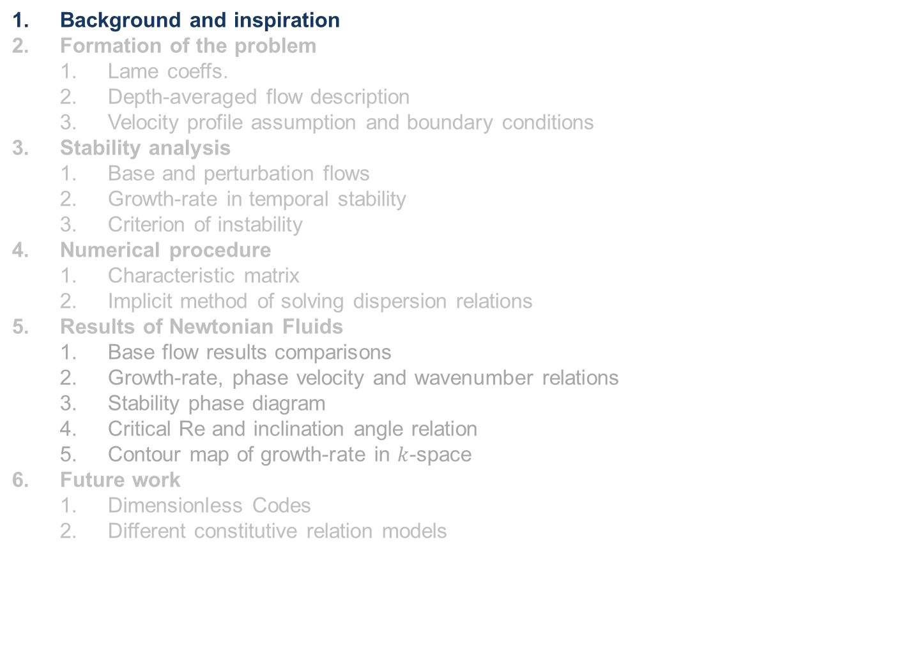
Outline
Background and inspiration
Formation of the problem
Lame coeffs.
Depth-averaged flow description
Velocity profile assumption and boundary conditions
Stability analysis
Base and perturbation flows
Growth-rate in temporal stability
Criterion of instability
Numerical procedure
Characteristic matrix
Implicit method of solving dispersion relations
Results of Newtonian Fluids
Base flow results comparisons
Growth-rate, phase velocity and wavenumber relations
Stability phase diagram
Critical Re and inclination angle relation
Contour map of growth-rate in $k$-space
Future work
Dimensionless Codes
Different constitutive relation models

Slide 4
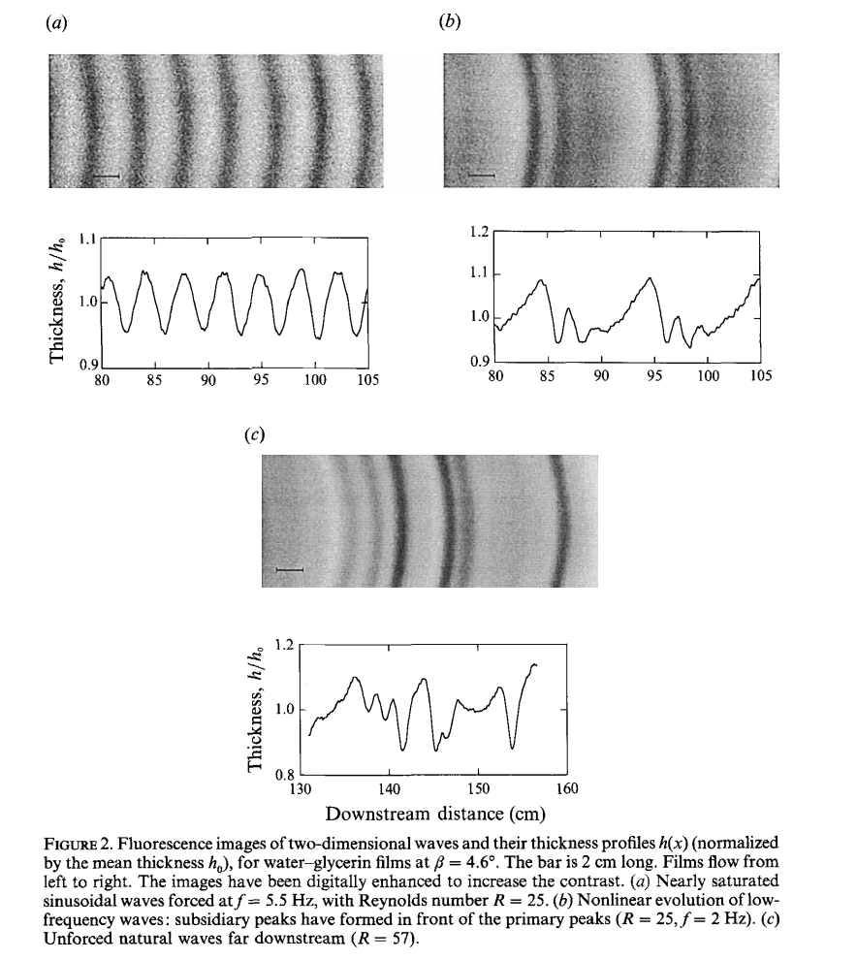
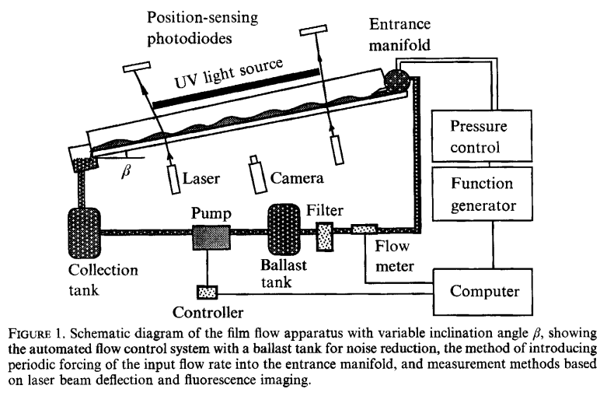
Background
The observation of instability
Ripple exists
Flow develops on a downward-sloping incline
Instability leads to the propagation of wave
Liu, J., Paul, J., & Gollub, J. (1993). Measurements of the primary instabilities of film flows. Journal of Fluid Mechanics, 250, 69-101. doi:10.1017/S0022112093001387

Slide 5
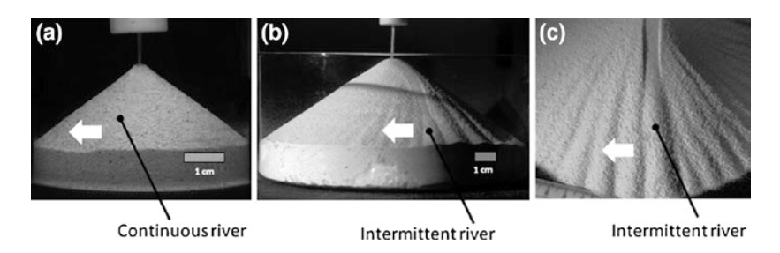

Inspiration
The observation of instability
Flow develops on a downward-sloping incline
Instability leads to the propagation of wave
Flat incline
Conical surface
2D $→$ 3D analysis
Fluid
Granular flow
Apply dif constitutive model
The observation of sandpiles instability
Altshuler, E., Ramos, O., Martínez, E., Batista-Leyva, A. J., Rivera, A., & Bassler, K. E. (2003). Sandpile formation by revolving rivers. Physical Review Letters, 91,014501

Slide 6
Motivation and goals
The observation of sandpiles instability
Altshuler, E., Ramos, O., Martínez, E., Batista-Leyva, A. J., Rivera, A., & Bassler, K. E. (2003). Sandpile formation by revolving rivers. Physical Review Letters, 91,014501
What conditions cause that instability?
How will this instability develop or not?

Slide 7
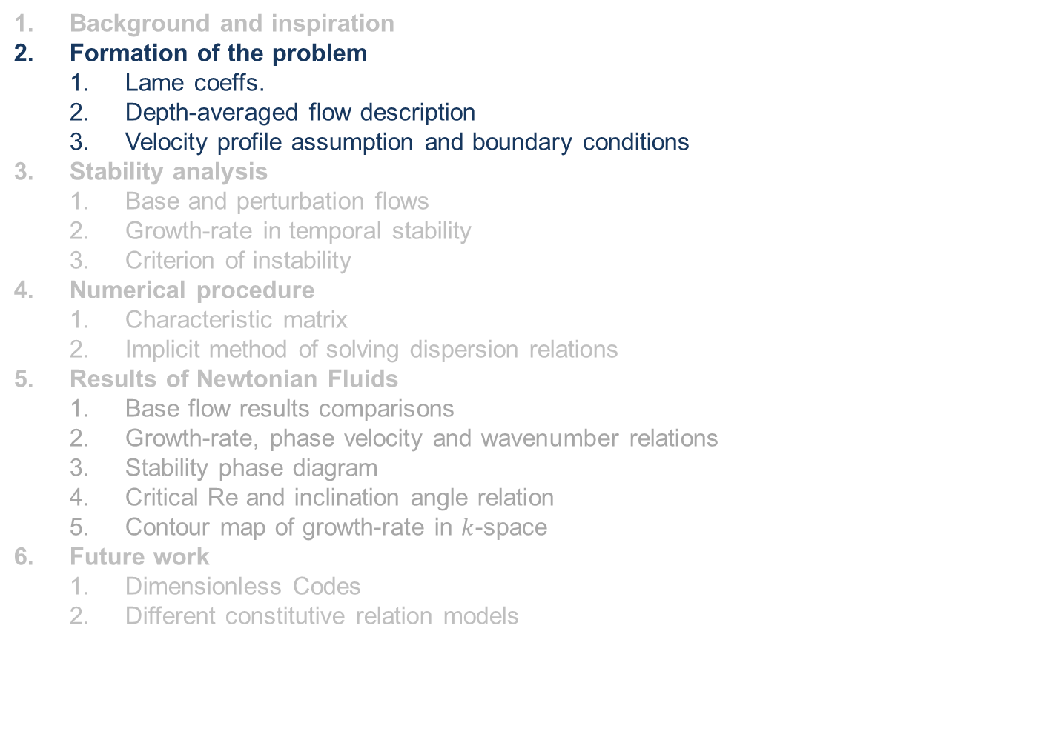
Outline
Background and inspiration
Formation of the problem
Lame coeffs.
Depth-averaged flow description
Velocity profile assumption and boundary conditions
Stability analysis
Base and perturbation flows
Growth-rate in temporal stability
Criterion of instability
Numerical procedure
Characteristic matrix
Implicit method of solving dispersion relations
Results of Newtonian Fluids
Base flow results comparisons
Growth-rate, phase velocity and wavenumber relations
Stability phase diagram
Critical Re and inclination angle relation
Contour map of growth-rate in $k$-space
Future work
Dimensionless Codes
Different constitutive relation models

Slide 8
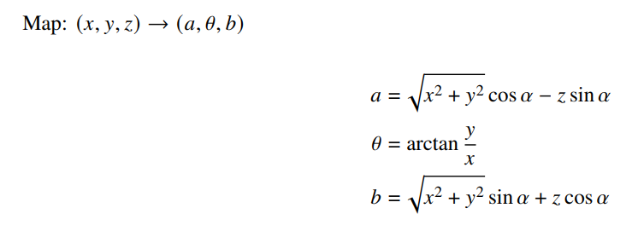
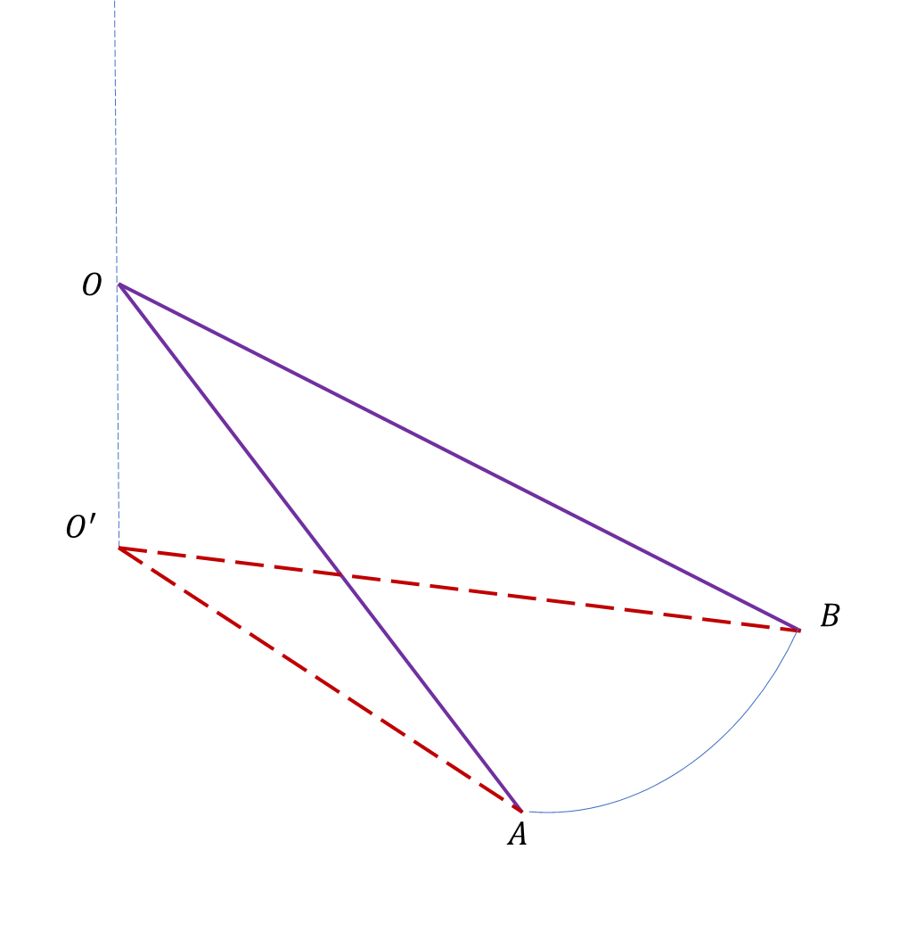
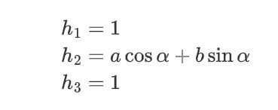
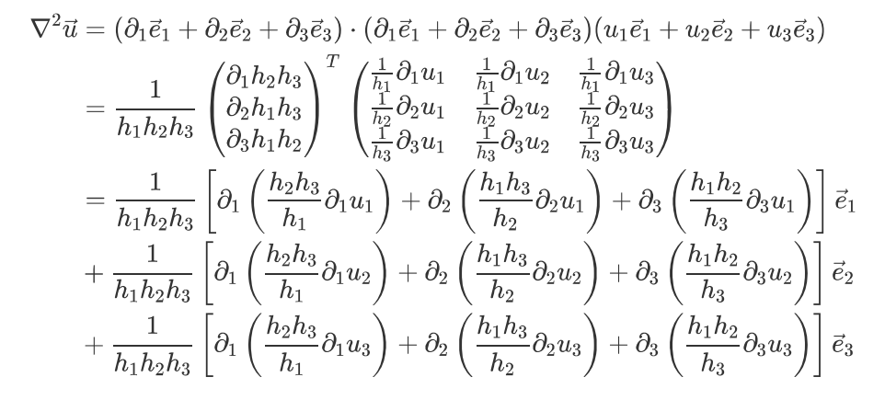
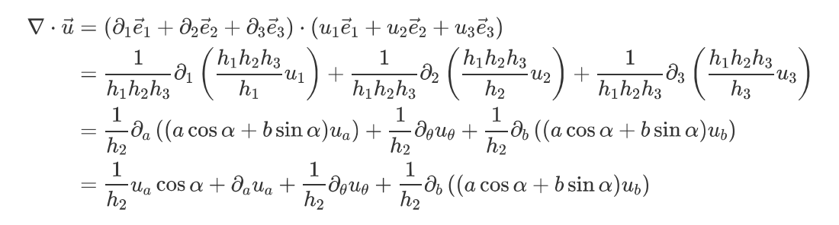

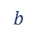
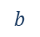
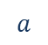
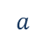

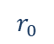

Formation of the problem : Coordinates transformation
$$r_{0}$$
$$b$$
$$⊙θ$$
$$a$$
Lame coefficients
$$b$$
Easily express differential derivations as the formal form
$$θ⊙$$
$$a$$
$$h$$

Slide 9
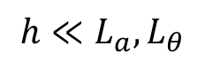

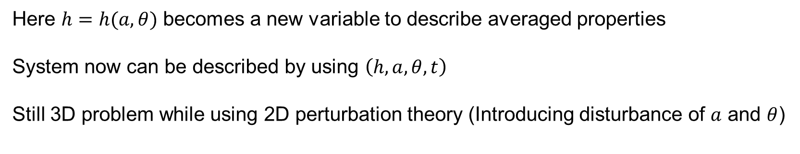
Formation of the problem: Depth-averaged method
Premise of this method: Horizontal length scales are much larger than the vertical
$$h≪L_{a},L_{θ}$$
$$b$$
Integrate governing eqns. along the vertical direction from $0$ to $h$
$$θ⊙$$
$$a$$
$$h$$
Use the depth-average quantities to discuss the instability on $a−θ$ plane
Question: Are we back to 2D perturbation problem? Not exactly
Here $h=h(a,θ)$ becomes a new variable to describe averaged properties
System now can be described by using $\left(h,a,θ,t\right)$
Still 3D problem while using 2D perturbation theory (Introducing disturbance of $a$ and $θ$)

Slide 10
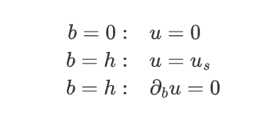
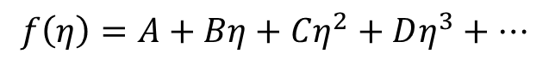
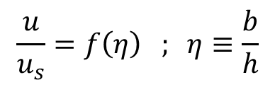
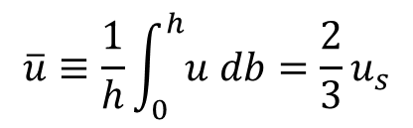

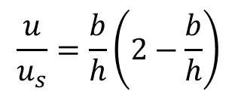
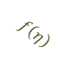
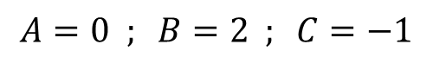
Formation of the problem: Velocity profile
Similarity hypothesis:
$$b$$
$$\frac{u}{u_{s}}=f\left(η\right) ; η≡\frac{b}{h}$$
$$θ⊙$$
$$a$$
Inside the thin layer, the horizontal velocity profile will maintain self-similarity
$$h$$
Thus we can assume that the function can be expanded as polynomial form:
$$f\left(η\right)=A+Bη+Cη^{2}+Dη^{3}+…$$
Apply boundary conditions
Use 3 conditions we can get 3 coeffs.
$$A=0 ; B=2 ; C=−1$$
Parabolic profile
Free surface
$$\frac{u}{u_{s}}=\frac{b}{h}\left(2−\frac{b}{h}\right)$$
$$\overline{u}≡\frac{1}{h}\int_{0}^{h}{u db}=\frac{2}{3}u_{s}$$
Wall surface
$$f\left(η\right)$$

Slide 11
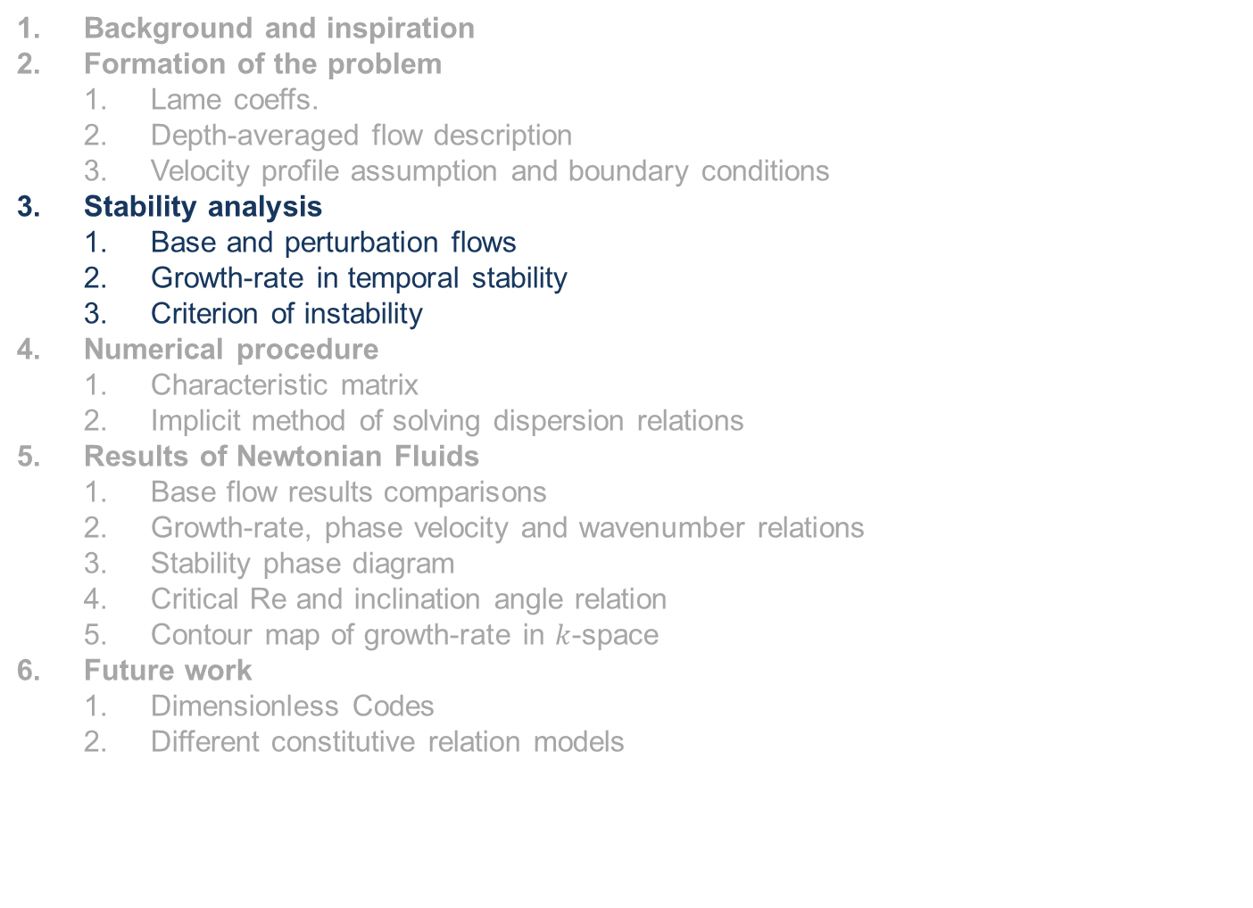
Outline
Background and inspiration
Formation of the problem
Lame coeffs.
Depth-averaged flow description
Velocity profile assumption and boundary conditions
Stability analysis
Base and perturbation flows
Growth-rate in temporal stability
Criterion of instability
Numerical procedure
Characteristic matrix
Implicit method of solving dispersion relations
Results of Newtonian Fluids
Base flow results comparisons
Growth-rate, phase velocity and wavenumber relations
Stability phase diagram
Critical Re and inclination angle relation
Contour map of growth-rate in $k$-space
Future work
Dimensionless Codes
Different constitutive relation models

Slide 12
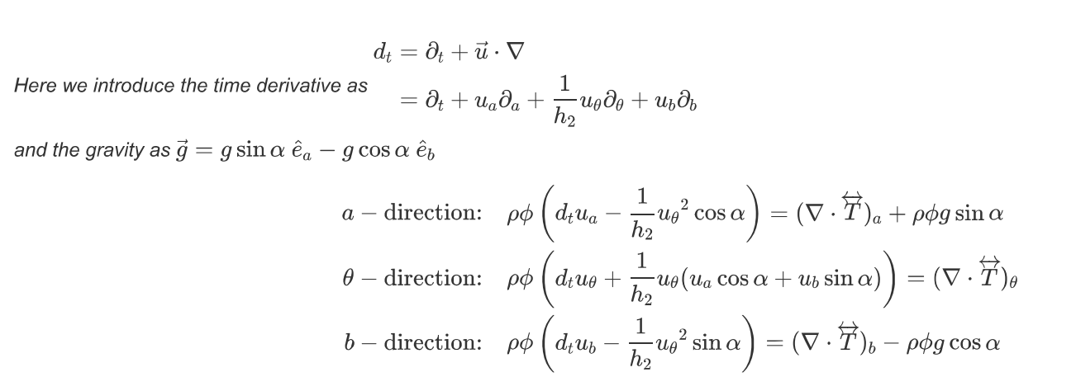
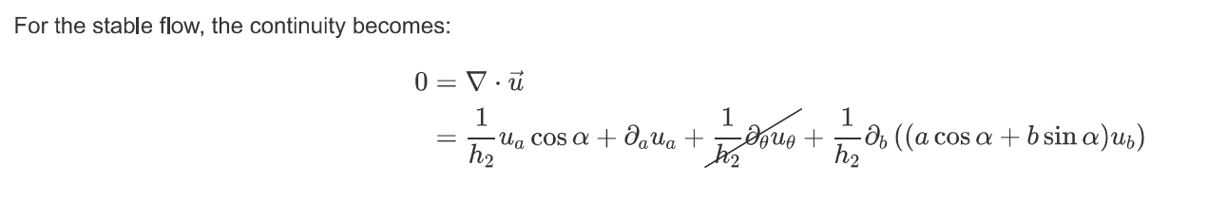
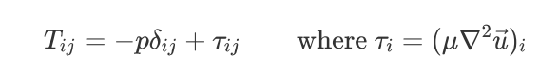
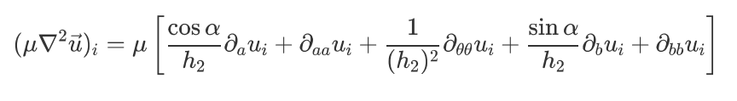
Base flow
Governing eqns.
At first we use basic constitutive relation to express the stress tensor

Slide 13
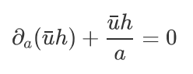
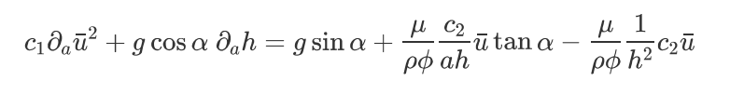

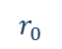
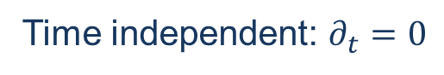
Base flow
Choose the stable flow along $a$ direction as the base flow
$$r_{0}$$
Flow down the busbar of the cone: $∂_{θ}=0 ; u_{θ}=0$
Time independent: $∂_{t}=0$
$$b$$
Integrate governing eqns. along thickness
$$⊙θ$$
$$a$$
Velocity profile
Simplified eqns. become

Slide 14
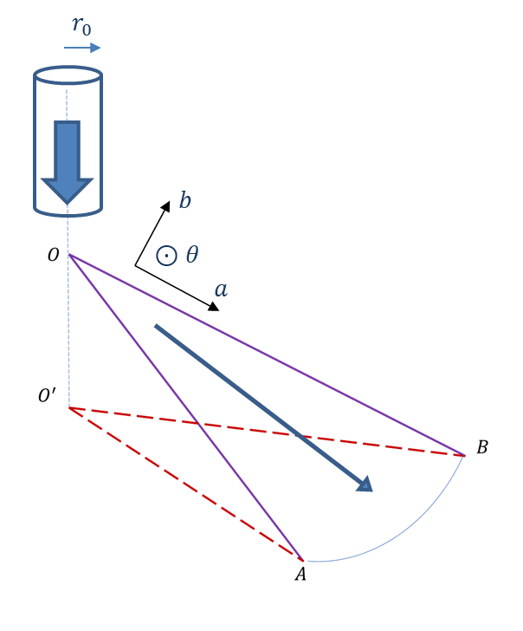
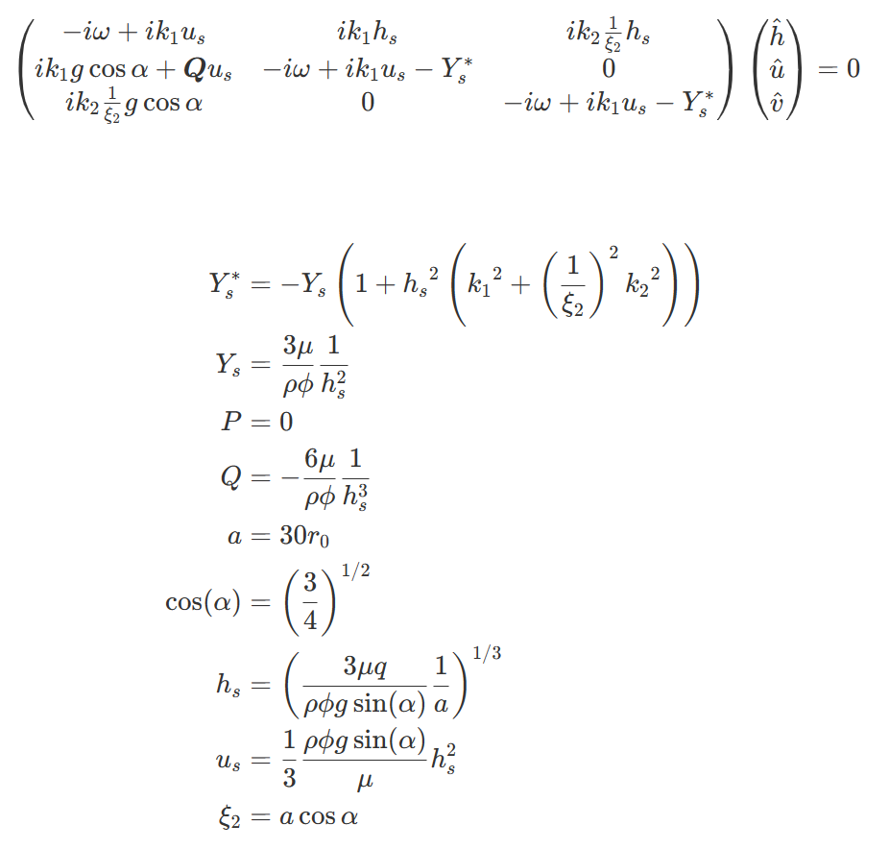
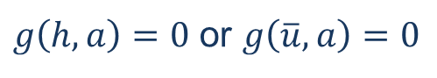
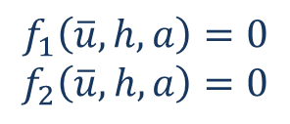
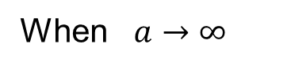
Base flow
Simplified eqns. become
$$f_{1}\left(\overline{u},h,a\right)=0$$
$$f_{2}\left(\overline{u},h,a\right)=0$$
$g\left(h,a\right)=0$ or $g\left(\overline{u},a\right)=0$
Here we can obtain $h=h\left(a\right) ; \overline{u}=\overline{u}(a)$ in base flow when $a=a_{0}$ is given
In stability analysis we focus on general effects of small perturbations,
thus a better argument is let $a_{0}$ be large enough
When $a→∞$
Here mark $s$ means stable case, not free surface any more

Slide 15
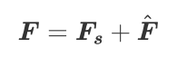
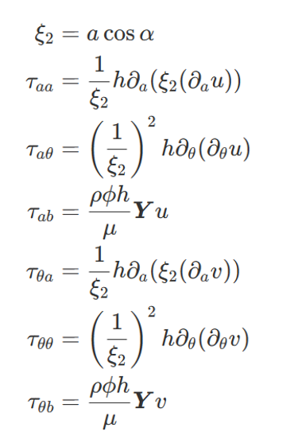
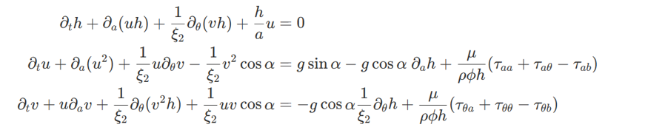
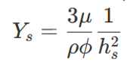
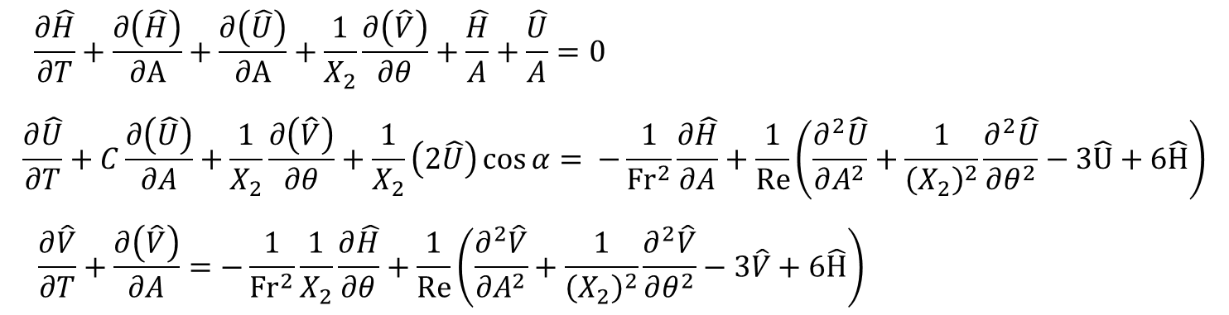
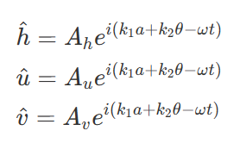
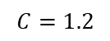
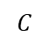
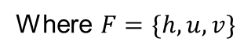
Perturbation flow
After use ${h_{s}(a}_{0}),u_{s}(a_{0})$to parameterize the base flow, it is easy to get disturbance equations
Where $F=\{h,u,v\}$
$$C=1.2$$
$$C$$
Notice that due to the homogeneity of eqns., fluctuating part can be expressed by normal mode method

Slide 16
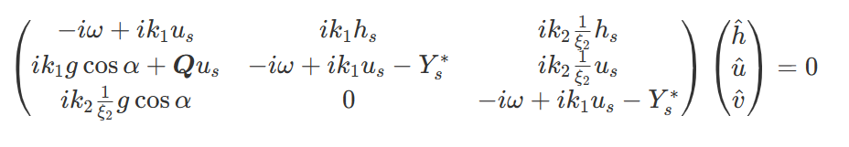
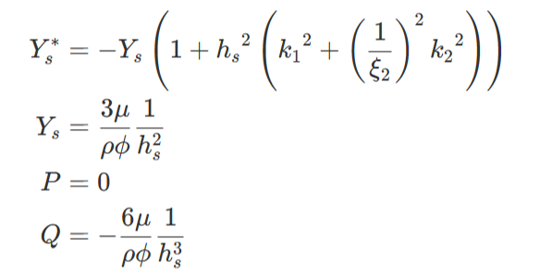
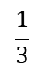




Perturbation flow
Then plug fluctuating part into governing eqns. and subtract the base flow part we can get
$$C$$
$$Γ F=0$$
$$\frac{1}{3}$$
If solutions $F$ are non-trivial, then
$$det\left(Γ\right)=0$$
$$C=1.2$$
At given $a_{0},Re,Fr$, we can obtain the dispersion relation
$$\left(ω_{1},ω_{2},ω_{3}\right)−(k_{1},k_{2})$$

Slide 17







Growth-rate in temporal stability
As we discussed, we fix at ${a=a}_{0}$ to find the evolution of the perturbation
$$r_{0}$$
After find out the dispersion relation, back to our perturbation form
$$b$$
Base flow
fix at ${a=a}_{0}$
$$⊙θ$$
$$a$$
Here we know that two wavenumbers $k_{1}$ and $k_{2}$ are real,
and also we can define them as positive real to match the reality case
While for $ω$(3 roots here: $ω_{1},ω_{2},ω_{3}$), after solving the dispersion relation it must be a complex number,
that is because the characteristic function is complex
$$ω=ω_{R}+iω_{I}$$
Thus when we consider exponential term of time, it will becomes
$$e^{−iωt}=e^{−{i(ω}_{R}+iω_{I})t}=e^{−iω_{R}t}e^{ω_{I}t}$$
Damping or Growing term

Slide 18




Criterion of instability
$$ω=ω_{R}+iω_{I}$$
$$r_{0}$$
Damping or Growing term
Thus when we consider exponential term of time, it will becomes
$$b$$
Base flow
fix at ${a=a}_{0}$
$$e^{−iωt}=e^{−{i(ω}_{R}+iω_{I})t}=e^{−iω_{R}t}e^{ω_{I}t}$$
$$⊙θ$$
$$a$$
When $ω_{I}>0$, it means when time goes up, these perturbations will diverge
When $ω_{I}<0$, it means when time goes up, these perturbations will damp
Thus the criterion is $ω_{I}=0$, and from the dispersion relation we can find
$$ω_{I}=ω_{I}(a_{0},Re,Fr,k_{1},k_{2})$$
At fixed $a_{0},Re,Fr$, the most likely observed wave phenomenon happens
$ω_{I}=\max{[ω_{I}]}$ in $ω_{I}>0$ ($k_{1},k_{2}$) region

Slide 19





Criterion of instability
Thus the criterion is $ω_{I}=0$, and from the dispersion relation we can find
$$ω_{I}=ω_{I}(a_{0},Re,Fr,k_{1},k_{2})$$
Also in this problem, these two dimensionless numbers are defined as
$$Re=\frac{\overline{u}h}{ν}$$
$$Fr=\frac{\overline{u}}{{\left(gh\cos{α}\right)}^{\frac{1}{2}}}$$
And more important is that we parameterize the base flow like:
$$\frac{Fr^{2}}{Re}=\frac{1}{3}\tan{α}$$
It leads to the relation between $Re$ and $Fr$:
Thus if we can fix incline angle $α$ and $a_{0}$, we can find the phase diagram $Re−k_{1},k_{2}$ due to the criterion
$Re_{cr}(α)$ will be shown in this diagram at fixed spatial point $a_{0}$

Slide 20

Outline
Background and inspiration
Formation of the problem
Lame coeffs.
Depth-averaged flow description
Velocity profile assumption and boundary conditions
Stability analysis
Base and perturbation flows
Growth-rate in temporal stability
Criterion of instability
Numerical procedure
Characteristic matrix
Implicit method of solving dispersion relations
Results of Newtonian Fluids
Base flow results comparisons
Growth-rate, phase velocity and wavenumber relations
Stability phase diagram
Critical Re and inclination angle relation
Contour map of growth-rate in $k$-space
Future work
Dimensionless Codes
Different constitutive relation models

Slide 21



Numerical procedure: Characteristic matrix
To solve the determinant of this matrix, it will be cubic complex equation $f\left(ω,k_{1},k_{2}\right)=0$ for $ω$
We can first use Symcal in MATLAB to get this cubic eqn.

Slide 22




Numerical procedure: Implicit method of solving dispersion relations
Now we get complex coeffs. of characteristic function like:
$$C_{1}ω^{3}+C_{2}ω^{2}+C_{3}ω+C_{4}=0$$
Notice that here $C_{1},C_{2},C_{3},C_{4}$ can be complex function of $k_{1},k_{2}$, they can be expressed as
$$C_{i}=C_{i}(k_{1},k_{2})$$
Here use roots in MATLAB directly, some issues may happen
Both real part and imag part solutions appear in different modes when roots in MATLAB performs numerical root finding
Just overlap to find correct results

Slide 23
Outline
Background and inspiration
Formation of the problem
Lame coeffs.
Depth-averaged flow description
Velocity profile assumption and boundary conditions
Stability analysis
Base and perturbation flows
Growth-rate in temporal stability
Criterion of instability
Numerical procedure
Characteristic matrix
Implicit method of solving dispersion relations
Results of Newtonian Fluids
Base flow results comparisons
Growth-rate, phase velocity and wavenumber relations
Stability phase diagram
Critical Re and inclination angle relation
Contour map of growth-rate in 𝑘-space
Future work
Dimensionless Codes
Different constitutive relation models

Slide 24





Not polished diagrams

Slide 25










A~60 H~1
$$Ω_{I}$$
$$Ω_{R}$$
$$C_{R}$$
$$K_{1}$$
$$K_{1}$$
$$K_{1}$$
$$K_{1}=0.03$$
Nearly linear

Slide 26







A~60 H~1
$$Ω_{I}$$
$$K_{2}$$
$$K_{1}$$
$$K_{2}$$
$$K_{1}$$

Slide 27






A~60 H~1
$$λ\frac{1}{X_{2}}∂_{aθ}U$$
Modify the stress term
$$K_{2}$$
$$K_{2}$$
$$K_{1}$$
$$K_{1}$$

Slide 28

Outline
Background and inspiration
Formation of the problem
Lame coeffs.
Depth-averaged flow description
Velocity profile assumption and boundary conditions
Stability analysis
Base and perturbation flows
Growth-rate in temporal stability
Criterion of instability
Numerical procedure
Characteristic matrix
Implicit method of solving dispersion relations
Results of Newtonian Fluids
Base flow results comparisons
Growth-rate, phase velocity and wavenumber relations
Stability phase diagram
Critical Re and inclination angle relation
Contour map of growth-rate in $k$-space
Future work
Dimensionless Codes
Different constitutive relation models

Slide 29

Future work
Use dimensionless form to recalculate all things
Choose different constitutive model
$$λ\frac{1}{X_{2}}∂_{aθ}U$$
Solve Orr-Sommerfeld equations without surface tension

Slide 30
Ref
[1] Altshuler, E., O. Ramos, E. Martínez, A. J. Batista-Leyva, A. Rivera and K. E. Bassler (2003). "Sandpile Formation by Revolving Rivers." Physical Review Letters 91(1): 014501.
[2] Altshuler, E., R. Toussaint, E. Martínez, O. Sotolongo-Costa, J. Schmittbuhl and K. J. Måløy (2008). "Revolving rivers in sandpiles: From continuous to intermittent flows." Physical Review E 77(3): 031305.
[3] Zhou, G., & Prosperetti, A. (2022). Hydraulic jump on the surface of a cone. Journal of Fluid Mechanics, 951, A20. doi:10.1017/jfm.2022.777
[4] Julia Zayko, Margarita Eglit; Stability of downslope flows to two-dimensional perturbations. Physics of Fluids 1 August 2019; 31 (8): 086601. https://doi.org/10.1063/1.5109314
[5] Allouche, M. H., S. Millet, V. Botton, D. Henry, H. Ben Hadid and F. Rousset (2015). "Stability of a flow down an incline with respect to two-dimensional and three-dimensional disturbances for Newtonian and non-Newtonian fluids." Physical Review E 92(6): 063010.
[6] Benjamin, T. (1957). Wave formation in laminar flow down an inclined plane. Journal of Fluid Mechanics, 2(6), 554-573. doi:10.1017/S0022112057000373
[7] Chia‐Shun Yih; Stability of Liquid Flow down an Inclined Plane. Phys. Fluids 1 March 1963; 6 (3): 321–334. https://doi.org/10.1063/1.1706737
[8] Liu, J., Paul, J., & Gollub, J. (1993). Measurements of the primary instabilities of film flows. Journal of Fluid Mechanics, 250, 69-101. doi:10.1017/S0022112093001387
[9] Anshus, B.E. and Goren, S.L. (1966), A method of getting approximate solutions to the orr-sommerfeld equation for flow on a vertical wall. AIChE J., 12: 1004-1008.https://doi.org/10.1002/aic.690120529

Slide 31
Thanks!

